Slide 1
Energy Consumption
Time Series Analysis
Bach Quang Minh
ICT2017
Email: minh.bach2017@ict.jvn.edu.vn

Slide 2
Outline
Data exploration
Methods
Results
Conclusions

Slide 3
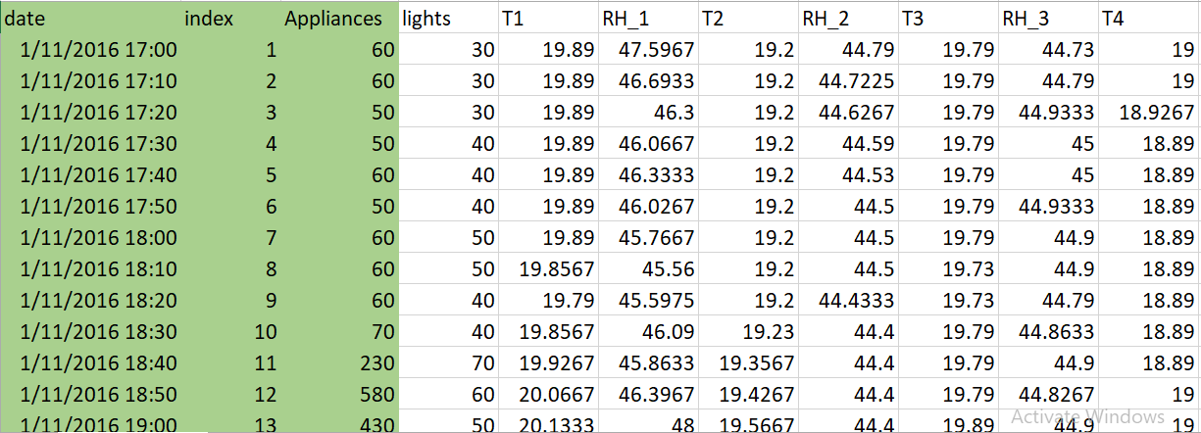
Energy consumption
Notes:
The data can be downloaded here: https://archive.ics.uci.edu/ml/datasets/Appliances+energy+prediction#
The data set is at 10 min for about 4.5 months, containing 19736 data points. Therefore, no time-point adjustments are needed.
The outcome of interest is the ‘Appliances’ column, which contains the energy consumption of the house.
For analysis task, a sample of 10 days from 1/12/2016 00:00 to 1/21/2016 23:50 was extracted from the data. Forecast is made for the next 2 hours, which is 12 data points a head.

Slide 4
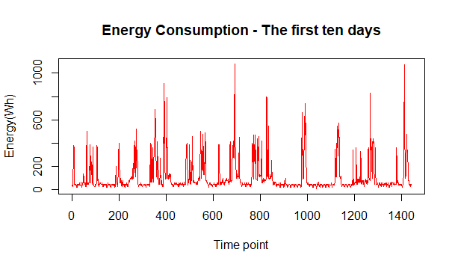
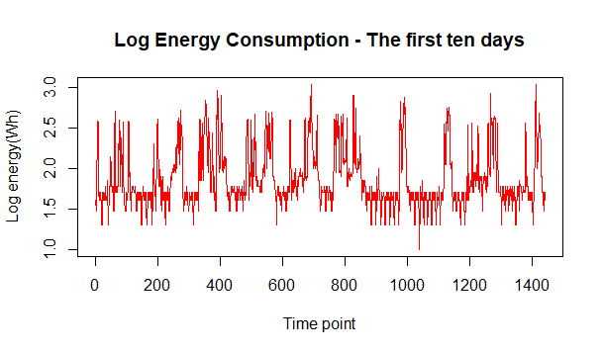
Data exploration
Notes:
On the original scale, the data shows to be quite stationary. The variance strongly varies. Some duration see strikes in energy, this could be due to the household activities.
A slight seasonality can also be seen.
To reduce the variability in the variance, the log10 transformation was applied to the data, producing a quite stationary-in-mean series.

Slide 5
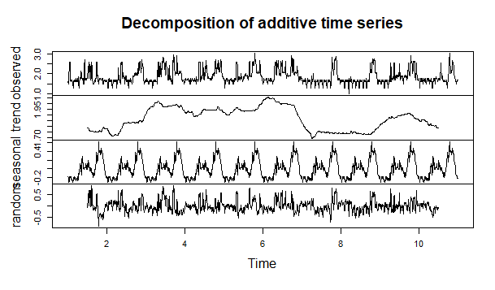
Data exploration
Notes:
To see if there is actually a seasonal component with respect to days, decomposition using lag 144 and additive method was applied.
From this graph, it can be seen that there exist a seasonal component with respect to days.
The trend is quite horizontal. The series is most affected by the trend and the seasonal component. The humps in the seasonal component matched those of the observed series. However, during days 7 to 9, there was a level trend making the observed values being dragged down.

Slide 6
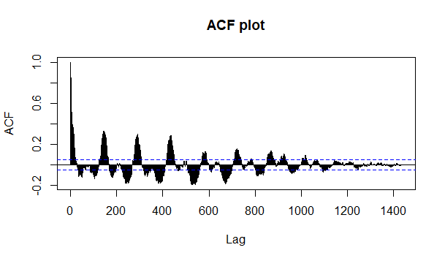
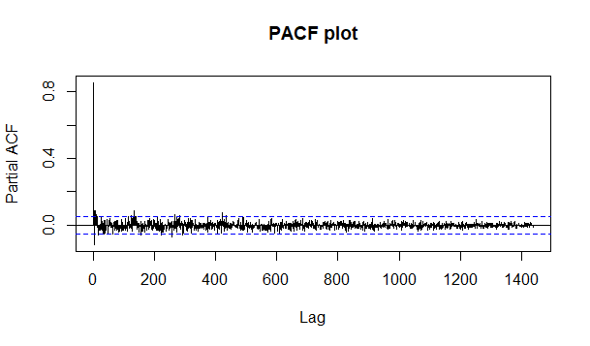
Data exploration
Notes:
The acf and pacf also indicate seasonality.

Slide 7
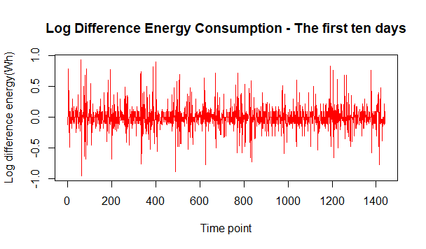
Stationarizing
Notes:
The first difference order with lag 1 was taken to stationarize the series

Slide 8
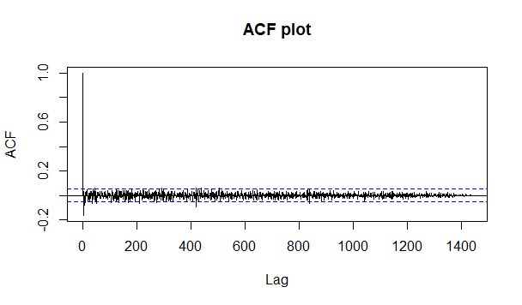
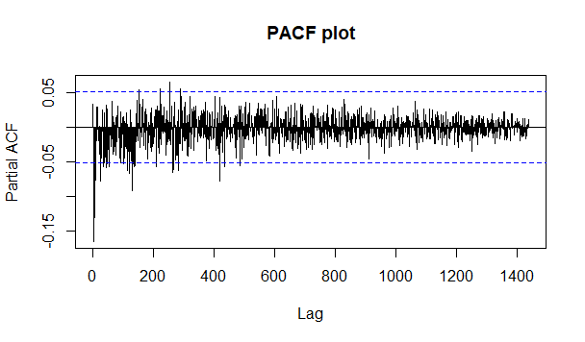
Stationarizing
Notes:
After stationarizing, the acf and pacf looks better, indicating it could be a good idea to take the first difference

Slide 9
Methods
AR1
ARMA(6,6)
ARIMA(6,2,6)
ARIMA(3,0,3)
Exponential Smoothing
Holt Winter
GARCH(6,6) – ARMA(6,6)
Notes:
AR1, ARMA(6,6) models was applied to the difference log series and inversed back to the original series

Slide 10
Models for Stationary

Slide 11
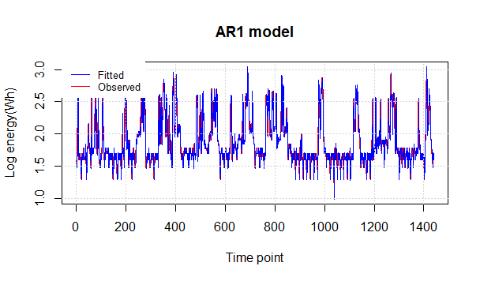
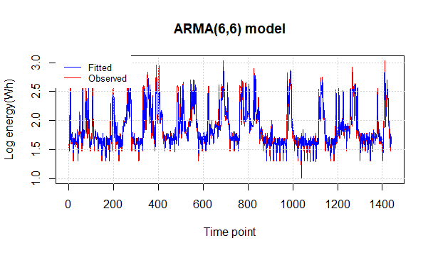
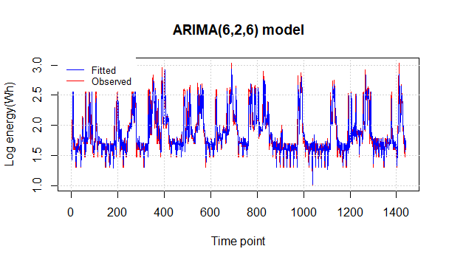

Notes:
Quality of fit of these models seems to be similar

Slide 12
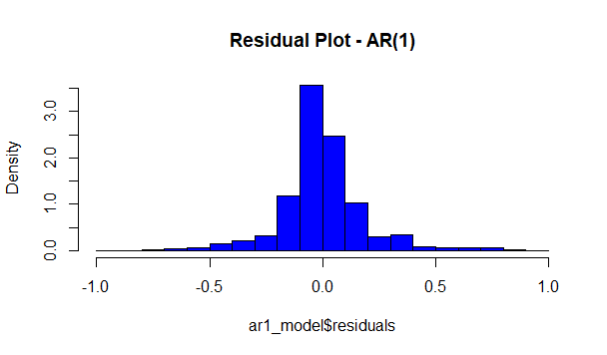
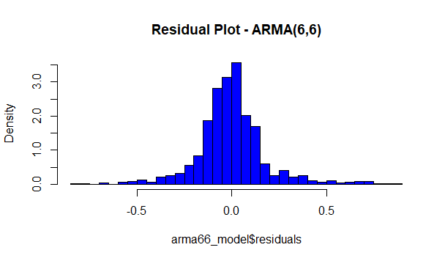
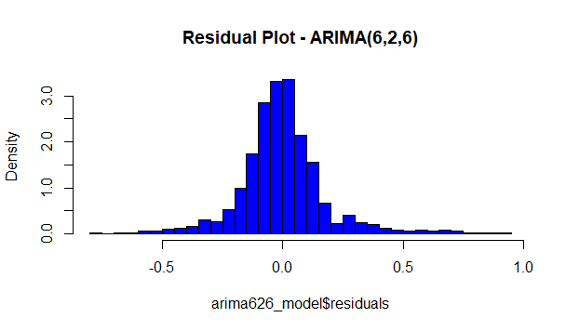
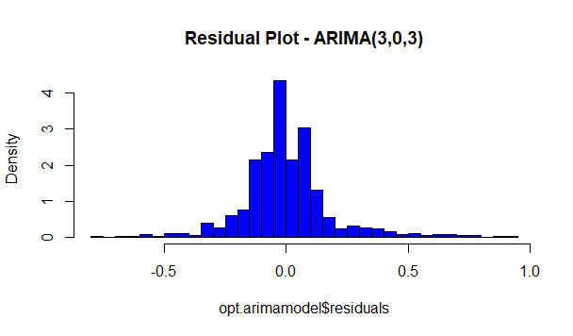
Notes:
The residual histogram of the model ARIMA show strongest sign of normal distribution with mean zero.

Slide 13
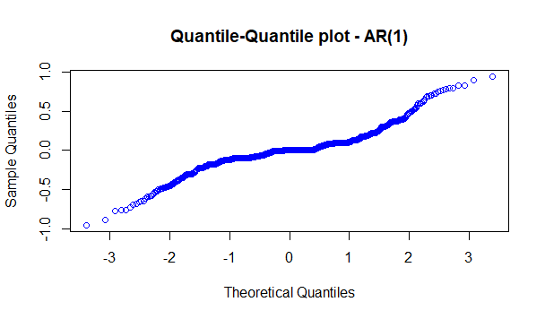
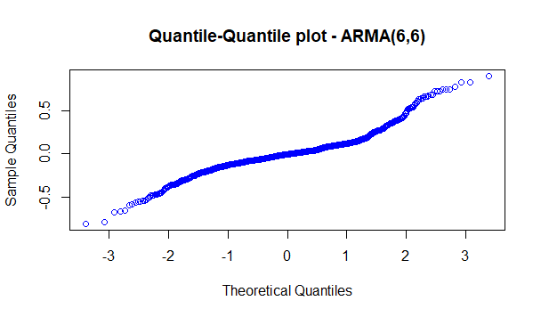

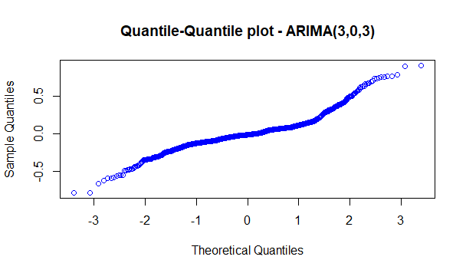
Notes:
QQ plots are pretty much the same

Slide 14
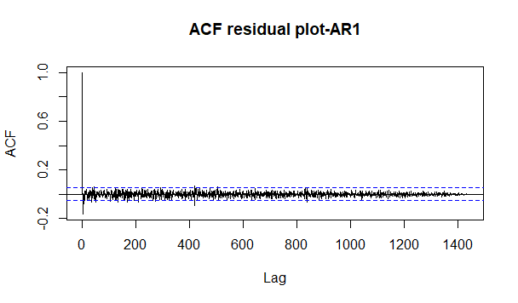
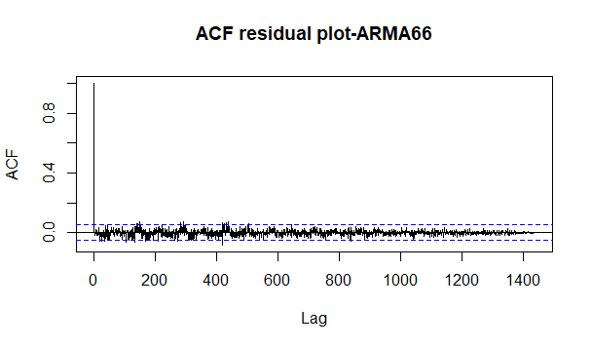
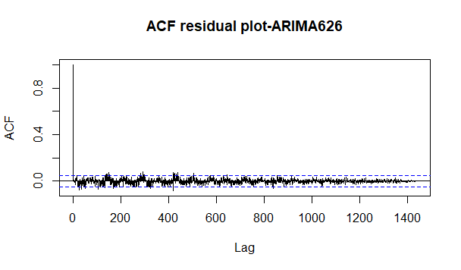
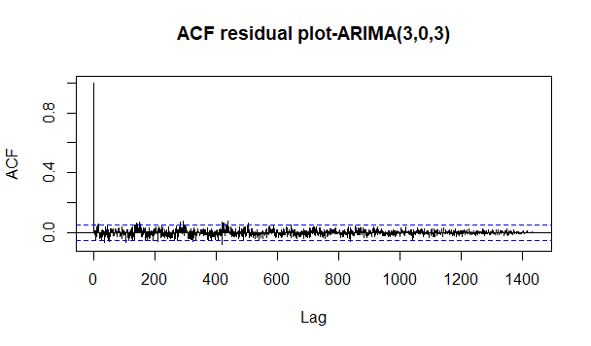
Notes:
AR1 model surprisingly showed strongest sign of uncorrelation of the residuals since it had no clear patterns. However, most models received small acf values.

Slide 15
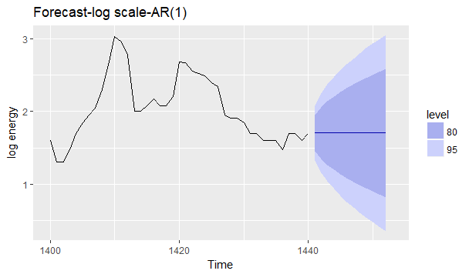
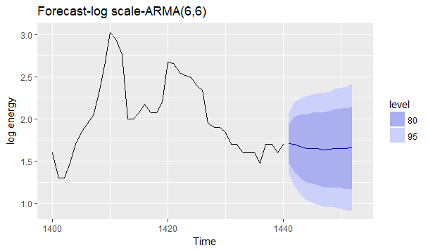
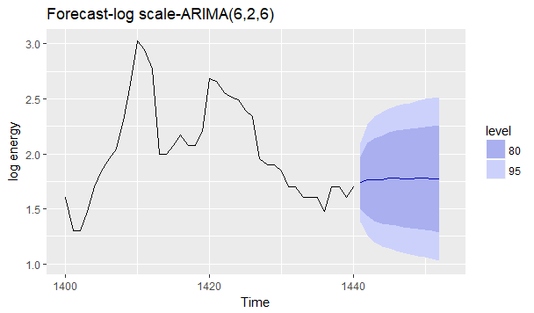
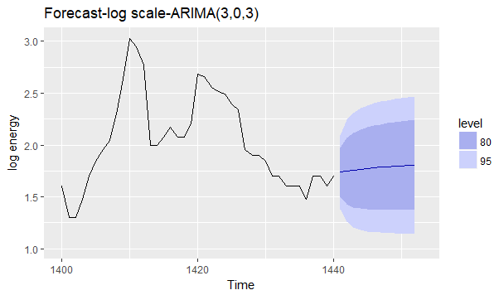
Notes:
Forecasting made by these model obtain similar results.

Slide 16
Exponential Smoothing

Slide 17
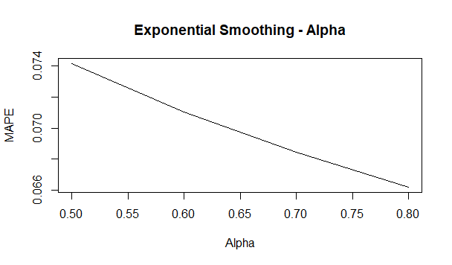
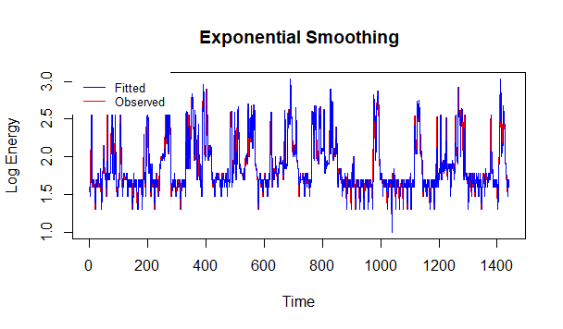
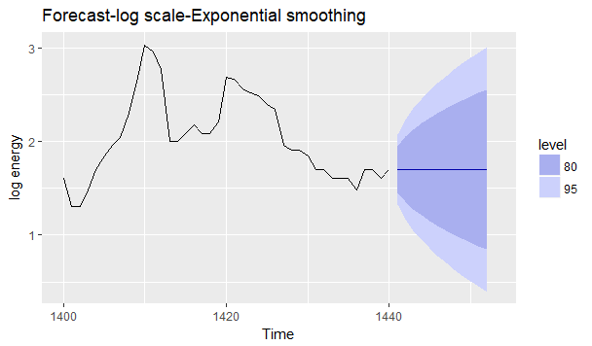
Notes:
Alpha MAPE was plot against the alpha values. This showed higher values of alpha yielded small values of MAPE. (it would be better if alpha values was fully plot ranging from 0 to 1. This will be fixed in the final report)
R package was used to produced the optimal alpha value (0.999922), which matched the alpha plot tendency. The forecast given by Exp. Smoo. was similar to that of the AR1.

Slide 18
Holt Winter

Slide 19
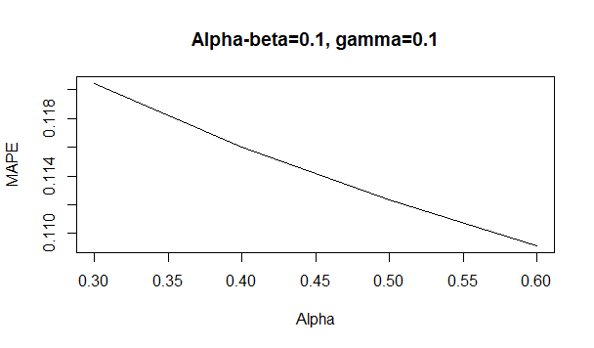
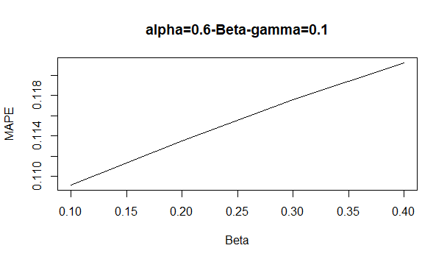
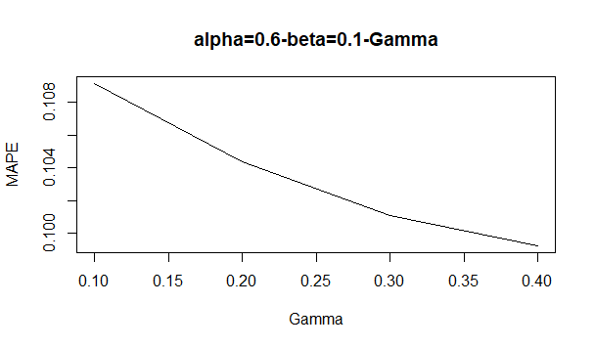
Notes:
MAPE was plot against each parameter value to investigate the effect of each parameter. It would be better if the parameters was fully plot from 0 to 1 (this will be fixed in the final report)

Slide 20
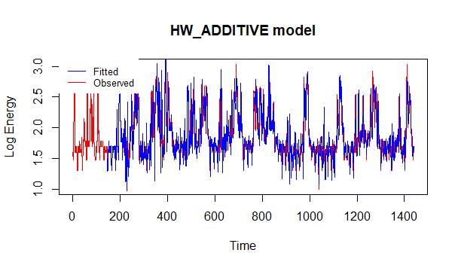
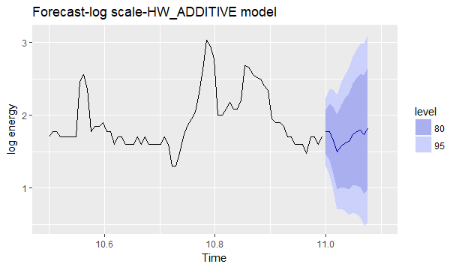
Notes:
The optimal parameter values was produced by R packages
The forecast looks more reasonable with slight fluctuations

Slide 21
GARCH-ARMA-6,6

Slide 22
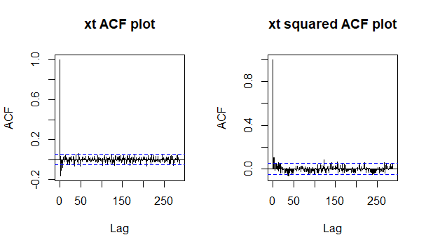
Notes:
GARCH-ARMA was also attempt. The act plot for xt^2 indicates changing variance

Slide 23
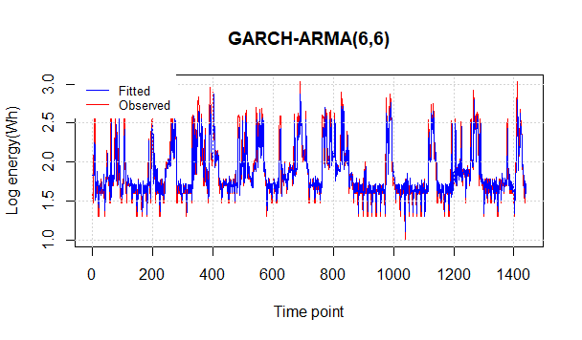
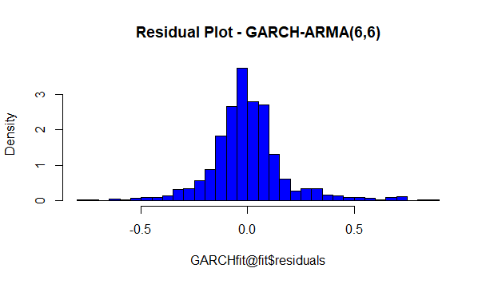
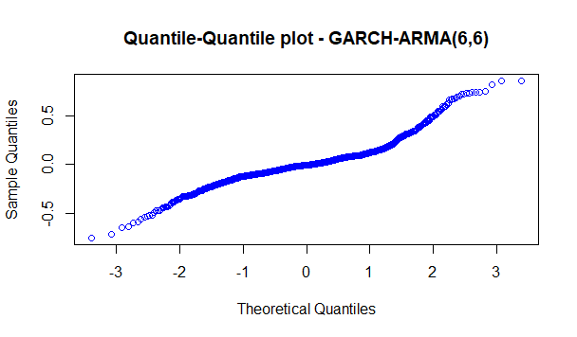
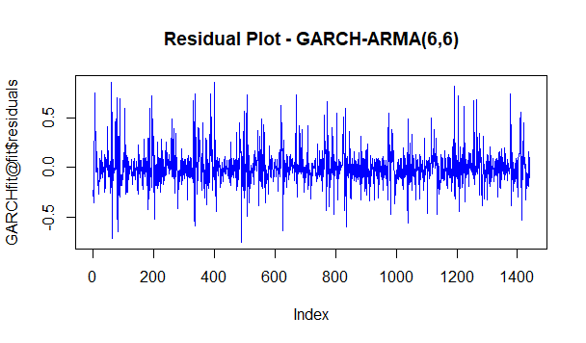
Notes:
The number 6 was chosen for p and q under the assumption that energy could be strongly correlated with values in previous hour.
The histogram, qq plot and residual plot shows good quality of fit.

Slide 24
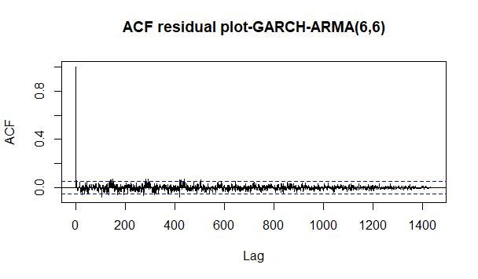

Slide 25
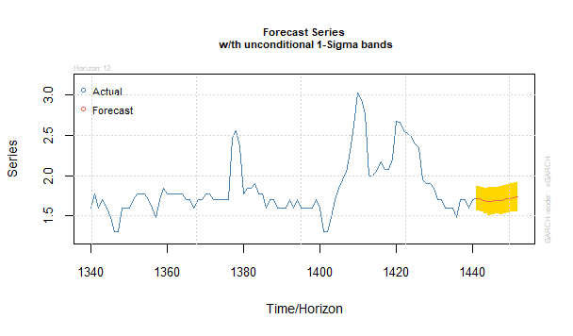
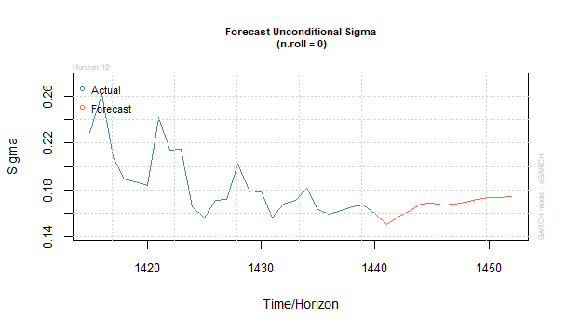
Notes:
The forecasted values were also similar to previous models

Slide 26
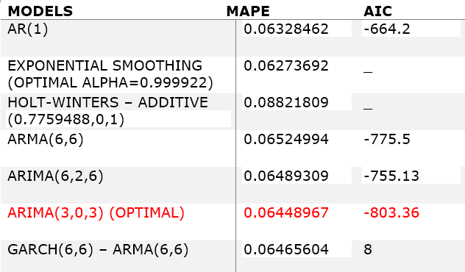
Results
Notes:
For model evaluation, MAPE was used to reduce confusion in the range of yt.
As can be seen, ARIMA(3,0,3) receives the lowest AIC value. This model was produced by the auto arima function in R.
AIC value for GARCH-ARIMA needed to be double checked since it was calculated manually.

Slide 27
Thank You!

